Slide 1

Introduction to Python Programming
Strings
Ms. Shital H. Dinde

Slide 2

Strings
In python, anything that you enclose between single or double quotation marks is considered a string. A string is essentially a sequence or array of textual data.

Slide 3
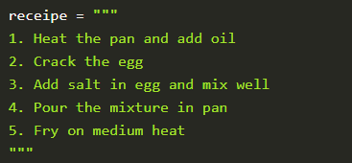
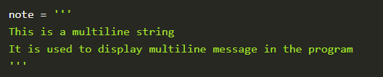
Multiline strings

Slide 4
String Methods
upper() : The upper() method converts a string to upper case.
lower() : The lower() method converts a string to upper case.
strip() : The strip() method removes any white spaces before and after the string.
rstrip() : the rstrip() removes any trailing characters.
replace() : the replace() method replaces a string with another string.
split() : The split() method splits the give string at the specified instance and returns the separated strings as list items.
capitalize() : The capitalize() method turns only the first character of the string to uppercase and the rest other characters of the string are turned to lowercase

Slide 5
String Methods
center() : The center() method aligns the string to the center as per the parameters given by the user.
count() : The count() method returns the number of times the given value has occurred within the given string.
endswith() : The endswith() method checks if the string ends with a given value. If yes then return True, else return False.
find() : The find() method searches for the first occurrence of the given value and returns the index where it is present. If given value is absent from the string then return -1.
isalnum() : The isalnum() method returns True only if the entire string only consists of A-Z, a-z, 0-9. If any other characters or punctuations are present, then it returns False.

Slide 6
String Methods
isalpha() : The isalnum() method returns True only if the entire string only consists of A-Z, a-z. If any other characters or punctuations or numbers(0-9) are present, then it returns False.
islower() : The islower() method returns True if all the characters in the string are lower case, else it returns False.
isspace() : The isspace() method returns True only and only if the string contains white spaces, else returns False.
isupper() : The isupper() method returns True if all the characters in the string are upper case, else it returns False.
startswith() : The endswith() method checks if the string starts with a given value. If yes then return True, else return False.

Slide 7
String Methods
swapcase() : The swapcase() method changes the character casing of the string. Upper case are converted to lower case and lower case to upper case.
title() : The title() method capitalizes each letter of the word within the string.
replace() : The replace() method can be used to replace a part of the original string with another string.

Slide 8
Write a python program to get a single string from two given strings, separated by a space and swap the first two characters of each string.
2. Write a python program to get a string from a given string where all occurrences of its first char have been changed to '$' except the first char itself
3. Write a Python function that accepts a string and calculate the number of uppercase letters and lower case letters.

Slide 9


Questions?

Slide 10

8888 763 563
88 5335 4141
https://svlautomations.in
https://svltrainings.in

